Slide 1


Slide 2




Reflection System in Thief
Peter Sikachev, Nicolas Longchamps
Eidos Montreal
Notes:
Hello and welcome to our talk

Slide 3


Trailer
Notes:
For those of you who didn’t play Thief, we’ll show a short gameplay trailer

Slide 4
Talk Schedule
Basic algorithms
Thief reflection system overview
Screen-space reflections
Image-based reflections
Contact-hardening glossy reflections
Reflection pipeline features
Localized cube map reflections
Art pipeline implications
Conclusion and QA
Notes:
Okay, let’s first review some existing work on reflection rendering

Slide 5

Basic Algorithms
Planar reflections
Notes:
Planar reflections were historically one of the first techniques for reflection rendering
They can very accurately depict reflections over the plane (hence the name) However, the cost is prohibitive (need to re-render the scene), does not work out of the box for non-planar objects

Slide 6
Basic Algorithms
Planar reflections
Cube map reflections
Notes:
Cube map reflections, conversely, work for all surface shapes However, capturing them dynamically is even more expensive
They usually lack resolution and do not show the contact very well
Static cube maps are very cheap

Slide 7
Basic Algorithms
Planar reflections
Cube map reflections
Image-based reflections
Notes:
Image-based reflections are, essentially, planar proxies, placed at important locations Tracing IBRs is much cheaper than reflections
IBRs are also static (as cube maps), but they correctly depict parallax
Rendering large number of IBRs could be prohibitive as well

Slide 8
Basic Algorithms
Planar reflections
Cube map reflections
Image-based reflections
Screen-space reflections
Notes:
SSR render reflections by ray-marching against the depth buffer
They are 100% dynamic and show perfectly contact reflections
However, they can reflect only objects on screen, therefore, a fallback technique is needed

Slide 9
Basic Algorithms
Planar reflections
Cube map reflections
Image-based reflections
Screen-space reflections
etc.
Localized cube maps
Image proxies on the plane
Bumped planar reflections
Hi-Z screen-space reflections
You name it!
Notes:
…and there many more variations of the given techniques, some of them are shown here

Slide 10
Talk Schedule
Basic algorithms
Thief reflection system overview
Screen-space reflections
Image-based reflections
Contact-hardening glossy reflections
Reflection pipeline features
Localized cube map reflections
Art pipeline implications
Conclusion and QA
Notes:
Ok, let’s talk now about the system we implemented for Thief

Slide 11
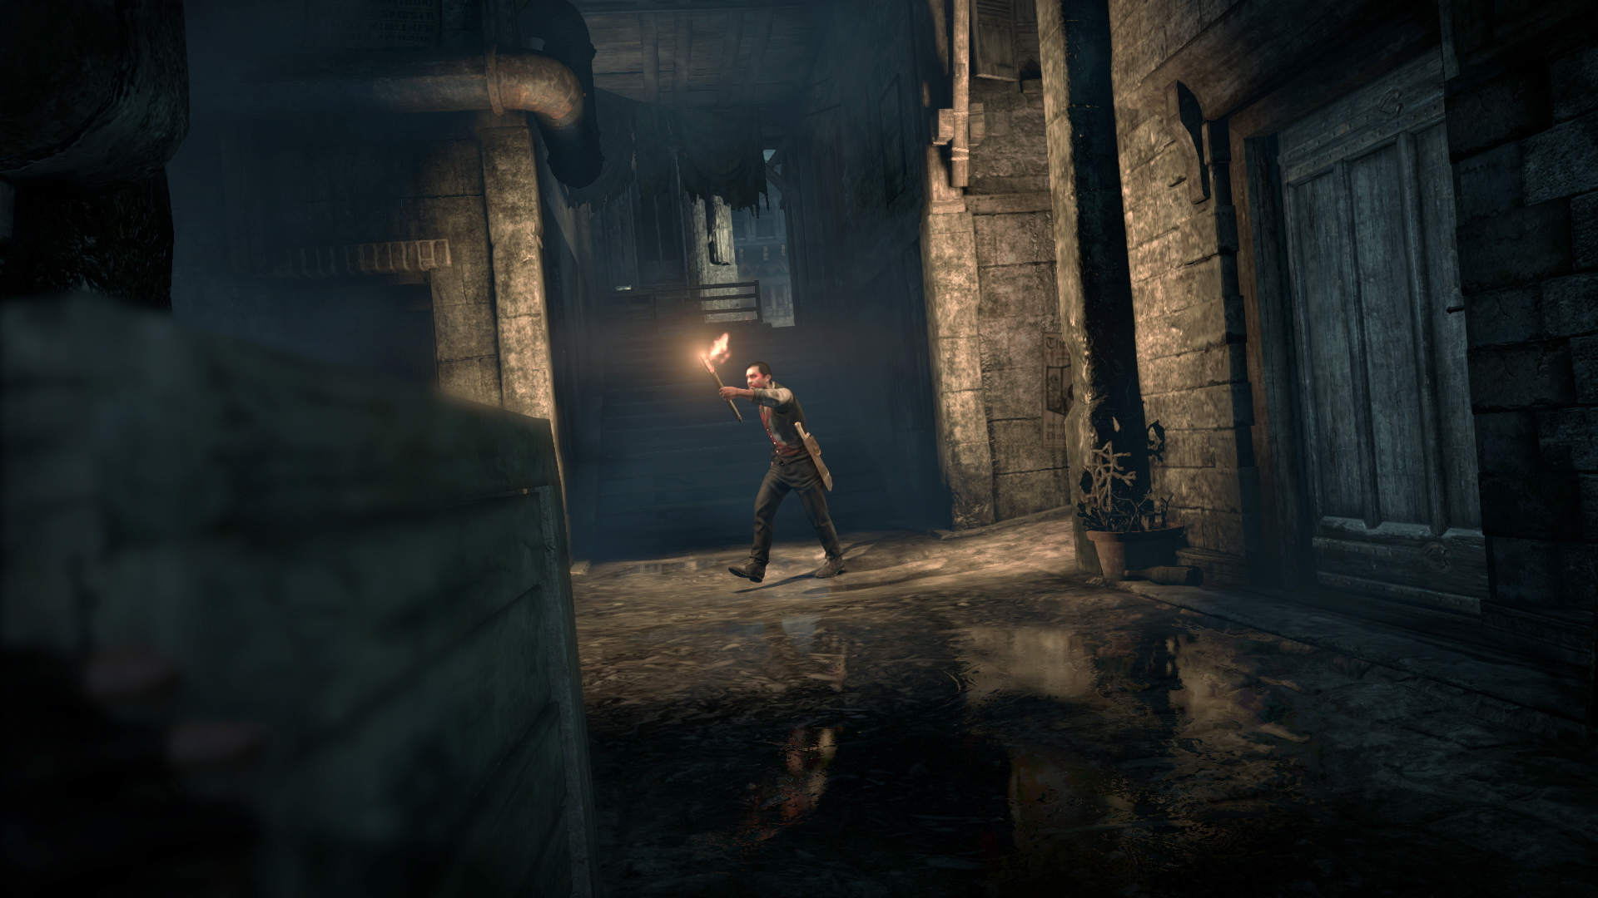
Reflection System Specifications
< 5 ms at next-gen platforms (PC/PS4/X1)
Multiple levels of reflecting surfaces
Human-height dynamic objects
Quasi-horizontal surfaces
Should capture principal landmarks
Thief © 2014 Square Enix Ltd. All rights reserved.
Notes:
Initially, we had the following requirements for the reflection system

Slide 12
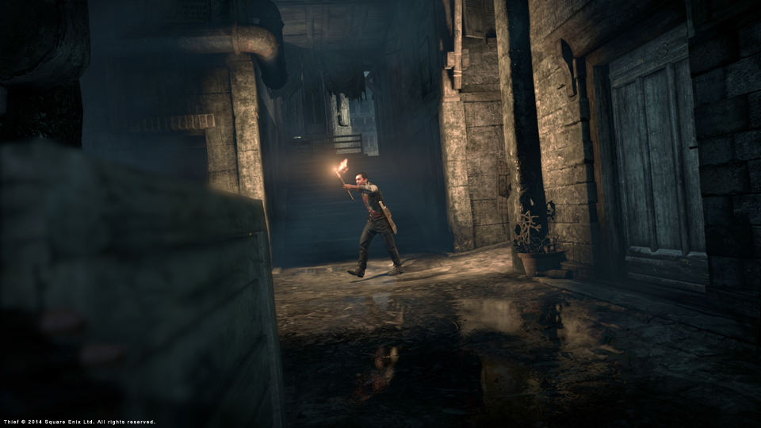
Reflection System
Solution: multi-tier reflection system
Each tier is responsible for capturing a particular feature
Notes:
As no single reflection algorithm was capable of satisfying all the requirements, we came up

Slide 13
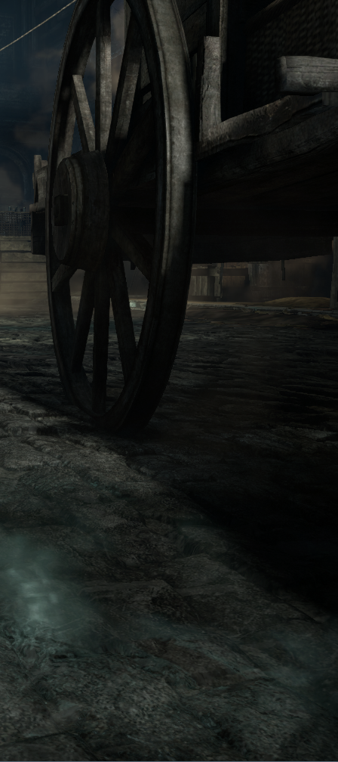
Reflection System
Solution: multi-tier reflection system
Each tier is responsible for capturing a particular feature
Cube map (local + global)
Thief © 2014 Square Enix Ltd. All rights reserved.

Slide 14
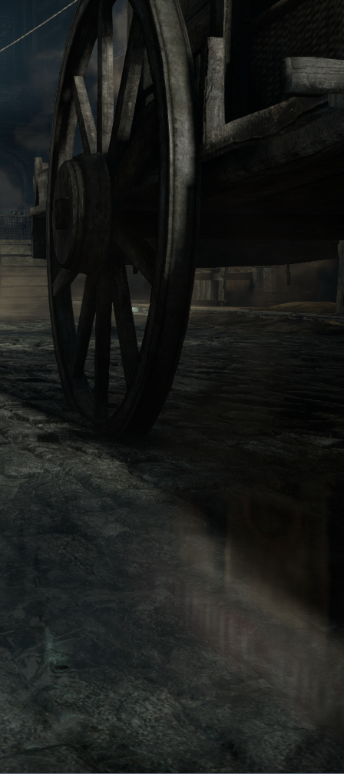
Reflection System
Solution: multi-tier reflection system
Each tier is responsible for capturing a particular feature
Cube map (local + global)
Image-based reflections (IBR)
Thief © 2014 Square Enix Ltd. All rights reserved.

Slide 15
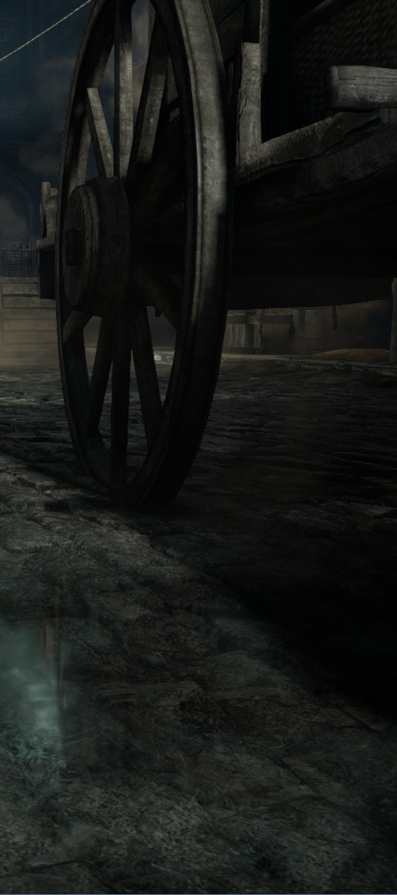
Reflection System
Solution: multi-tier reflection system
Each tier is responsible for capturing a particular feature
Cube map (local + global)
Image-based reflections (IBR)
Screen-space reflections (SSR)
Thief © 2014 Square Enix Ltd. All rights reserved.

Slide 16
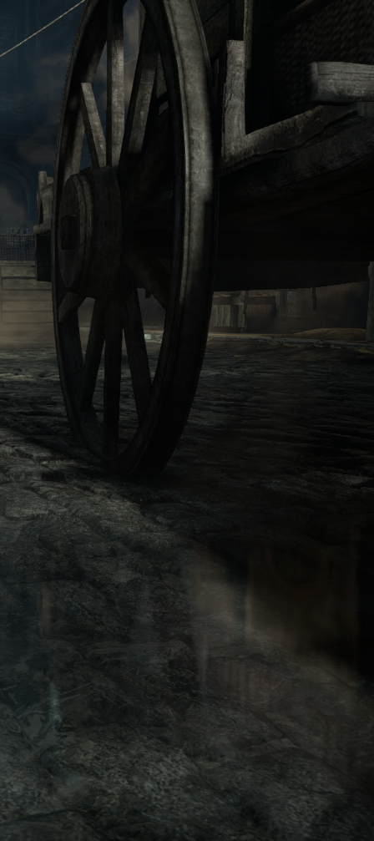
Reflection System
Solution: multi-tier reflection system
Each tier is responsible for capturing a particular feature
Cube map (local + global)
Image-based reflections (IBR)
Screen-space reflections (SSR)
Thief © 2014 Square Enix Ltd. All rights reserved.

Slide 17
Talk Schedule
Basic algorithms
Thief reflection system overview
Screen-space reflections
Image-based reflections
Contact-hardening glossy reflections
Reflection pipeline features
Localized cube map reflections
Art pipeline implications
Conclusion and QA
Notes:
Let’s now talk in-detail about each layer of the system

Slide 18
Screen-Space Reflections
reflected object
reflective surface
Notes:
Here’s a diagram of the SSR setup We make few linear steps, shown in green

Slide 19
Screen-Space Reflections
reflected object
reflective surface

Slide 20
Screen-Space Reflections
reflected object
reflective surface

Slide 21
Screen-Space Reflections
reflected object
reflective surface
Notes:
And then perform few binary steps for more precise results

Slide 22
Screen-Space Reflections
reflected object
reflective surface

Slide 23
Screen-Space Reflections
reflected object
reflective surface

Slide 24
SSR Optimizations
Normal is approximated with (0, 0, 1), bump is a post-process
Better memory coalescing – more useful data per DRAM burst
Notes:
However, the algorithm is largely texture fetch bound Here are the steps we do to facilitate faster running time

Slide 25
SSR Optimizations
Normal is approximated with (0, 0, 1), bump is a post-process
Better memory coalescing – more useful data per DRAM burst
Early outs

Slide 26
SSR Optimizations
Normal is approximated with (0, 0, 1), bump is a post-process
Better memory coalescing – more useful data per DRAM burst
Early outs
Exit if reflection low

Slide 27
Early Out Hazards
...
float4 res = 0;
//Early out
if (reflectionFactor < epsilon)
{
return res;
}
...
res = tex2D(...);
...
What’s wrong with this code?
Notes:
However, naively implemented early out approach might not increase the performance at all For instance, this code will not generate a dynamic branching instruction

Slide 28
Early Out Hazards
...
float4 res = 0;
//Early out
[branch]
if (reflectionFactor < epsilon)
{
return res;
}
...
res = tex2D(...);
...
X4121: gradient based operation must be moved outside of flow control to prevent divergence
Notes:
The reason why would be more obvious if we explicitly force the branch

Slide 29
Early Out Hazards
...
float4 res = 0;
//Early out
[branch]
if (reflectionFactor < epsilon)
{
return res;
}
...
res = tex2Dlod(...);
...
Use non-gradient instructions and force branches!

Slide 30
SSR Optimizations
Normal is approximated with (0, 0, 1), bump is a post-process
Better memory coalescing – more useful data per DRAM burst
Early outs
Exit if reflection low

Slide 31
SSR Optimizations
Normal is approximated with (0, 0, 1), bump is a post-process
Better memory coalescing – more useful data per DRAM burst
Early outs
Exit if reflection low
Exit on first depth buffer intersection

Slide 32
Early Out Hazards
reflected objects
real reflection
first hit
reflective surface
Notes:
Strictly speaking, exiting on the first intersection is not correct, as the first hit might not correspond to the real reflection

Slide 33
SSR Optimizations
Normal is approximated with (0, 0, 1), bump is a post-process
Better memory coalescing – more useful data per DRAM burst
Early outs
Exit if reflection low
Exit on first depth buffer intersection

Slide 34

SSR Optimizations
Normal is approximated with (0, 0, 1), bump is a post-process
Better memory coalescing – more useful data per DRAM burst
Early outs
Exit if reflection low
Exit on first depth buffer intersection
Exit if $\left(\vec{eye},\vec{r}\right)>0$ – Fresnel factor is low at these fragments anyway

Slide 35

SSR Optimizations
Normal is approximated with (0, 0, 1), bump is a post-process
Better memory coalescing – more useful data per DRAM burst
Early outs
Exit if reflection low
Exit on first depth buffer intersection
Exit if $\left(\vec{eye},\vec{r}\right)>0$ – Fresnel factor is low at these fragments anyway
Decrease number of samples due to distance ($d$)
$$N_{linear_samples}=max⁡(1, k_{1}e^{−ik_{2}d})$$

Slide 36

SSR Optimizations
Normal is approximated with (0, 0, 1), bump is a post-process
Better memory coalescing – more useful data per DRAM burst
Early outs
Exit if reflection low
Exit on first depth buffer intersection
Exit if $\left(\vec{eye},\vec{r}\right)>0$ – Fresnel factor is low at these fragments anyway
Decrease number of samples due to distance ($d$)
$$N_{linear_samples}=max⁡(1, k_{1}e^{−ik_{2}d})$$
Render in half-res
Significant speedup
High-frequency data is reconstructed in post-process bump

Slide 37

SSR Optimizations
Normal is approximated with (0, 0, 1), bump is a post-process
Better memory coalescing – more useful data per DRAM burst
Early outs
Exit if reflection low
Exit on first depth buffer intersection
Exit if $\left(\vec{eye},\vec{r}\right)>0$ – Fresnel factor is low at these fragments anyway
Decrease number of samples due to distance ($d$)
$$N_{linear_samples}=max⁡(1, k_{1}e^{−ik_{2}d})$$
Render in half-res
Significant speedup
High-frequency data is reconstructed in post-process bump
Worst case timings (fullscreen) ~1-1.5 ms
Really hard to achieve on real map though!

Slide 38
Talk Schedule
Basic algorithms
Thief reflection system overview
Screen-space reflections
Image-based reflections
Contact-hardening glossy reflections
Reflection pipeline features
Localized cube map reflections
Art pipeline implications
Conclusion and QA
Notes:
Ok, now let’s talk about our take on IBR reflections

Slide 39
Image-Based Reflections
UE3 reflections are good

Slide 40
Image-Based Reflections
UE3 reflections are good
We need ~50 IBR proxies per frame

Slide 41
Image-Based Reflections
UE3 reflections are good
We need ~50 IBR proxies per frame
8-10 ms in FullHD

Slide 42

Image-Based Reflections
UE3 reflections are good
We need ~50 IBR proxies per frame
8-10 ms in FullHD
Notes:
And we were not extremely happy with those results

Slide 43
IBR Optimizations
Good old half-res
Notes:
Ok, so here are the methods we used to bring IBRs to an affordable price

Slide 44
IBR Optimizations
Good old half-res
IBR rooms
Localize IBRs to particular level locations
Limit IBR reflections when looking down

Slide 45
IBR Optimizations
Good old half-res
IBR rooms
Localize IBRs to particular level locations
Limit IBR reflections when looking down
Tiled rendering
Uses quasi-horizontal reflector assumption
Empirical; no proof provided

Slide 46
IBR Tiled Rendering
Divide screen into vertical tiles

Slide 47
IBR Tiled Rendering
Divide screen into vertical tiles
Calculate proxy AABB projection

Slide 48
IBR Tiled Rendering
Divide screen into vertical tiles
Calculate proxy AABB projection
Extend vertical sides to the intersection with screen

Slide 49
IBR Tiled Rendering
Divide screen into vertical tiles
Calculate proxy AABB projection
Extend vertical sides to the intersection with screen
Add proxy to the affected tiles

Slide 50
IBR Optimizations
Old good half-res
IBR rooms
Localize IBRs to particular level locations
Tiled rendering
Uses quasi-horizontal reflector assumption
Empirical; no proof provided
Worst case timings (fullscreen) ~1-1.5 ms
Notes:
Once again – those timings hold if you are looking in FullHD at the plane which reflects in each single point

Slide 51
Talk Schedule
Basic algorithms
Thief reflection system overview
Screen-space reflections
Image-based reflections
Contact-hardening glossy reflections
Reflection pipeline features
Localized cube map reflections
Art pipeline implications
Conclusion and QA
Notes:
As an extra, we decided to add the contact-hardening effect to reflections

Slide 52
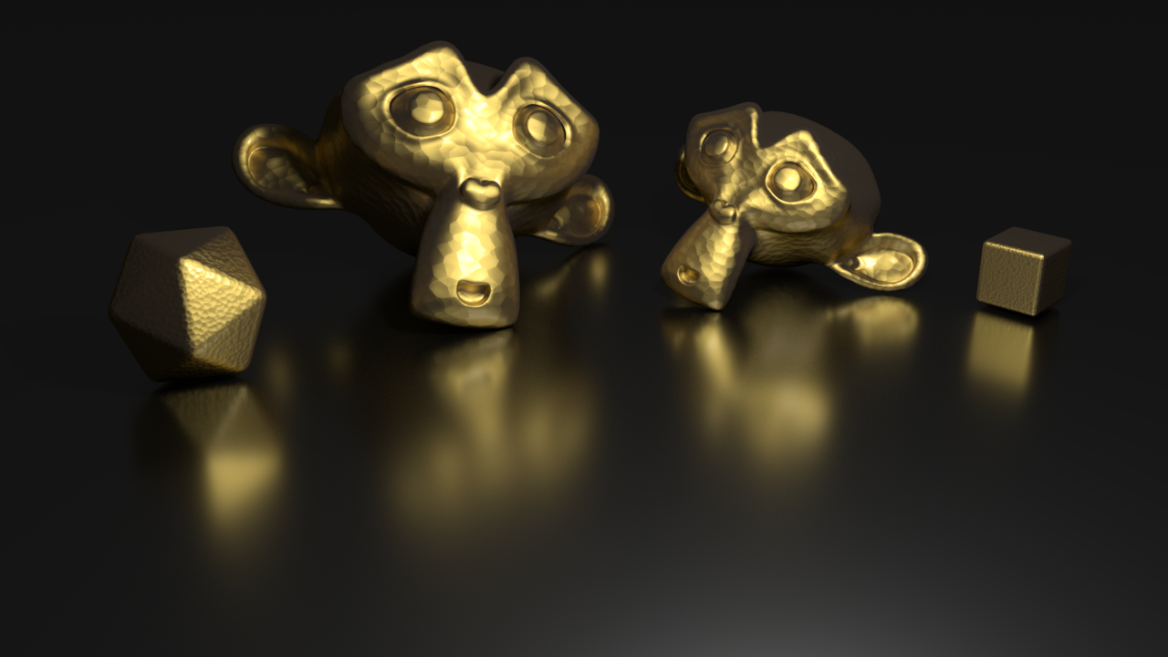
CHGS Justification
On glossy surfaces reflection rays diverge
Depends on distance between a reflector and a reflected object

Slide 53
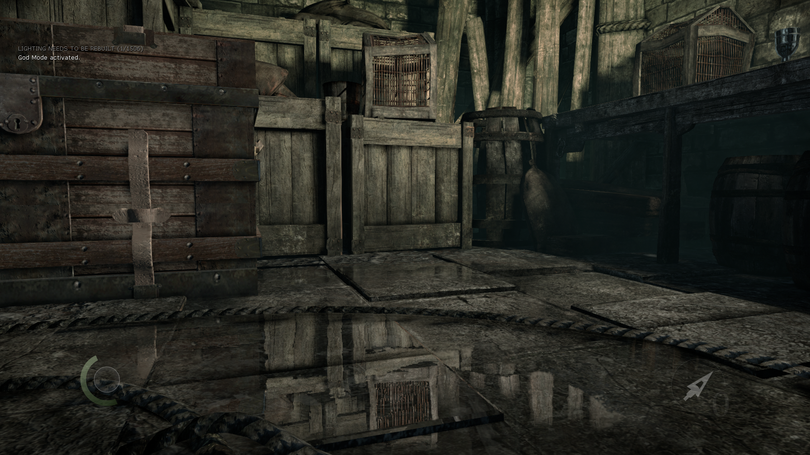
CHGS Approach (Before)
Output reflected distance
Pack into 2 bytes with 4 mm precision
Also used for sorting (hence the accuracy)
Dilate distance
Similar issues to DoF approaches
Blur (2-pass Gaussian)
Thief © 2014 Square Enix Ltd. All rights reserved.
Notes:
So, here is the CHGS algorithm outline

Slide 54
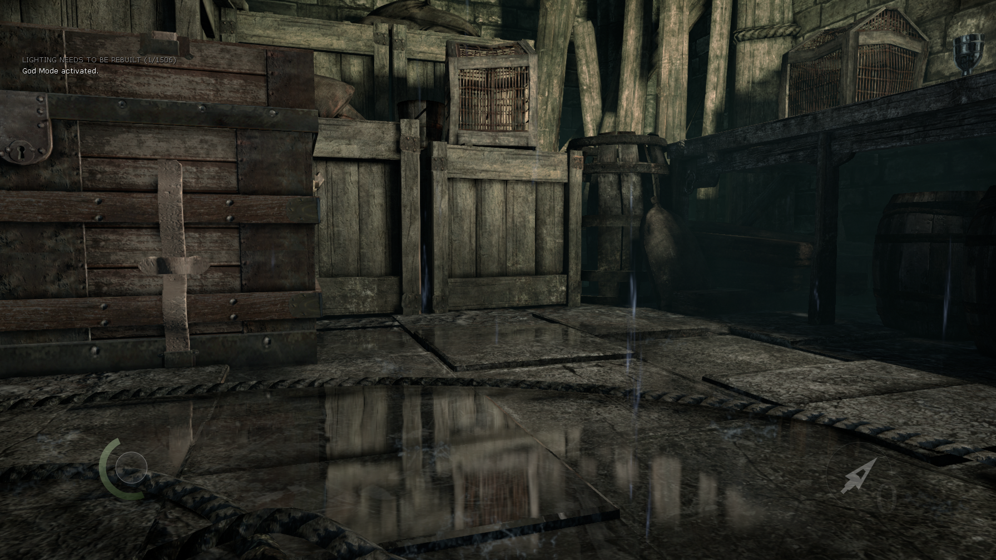
CHGS Approach (After)
Output reflected distance
Pack into 2 bytes with 4 mm precision
Also used for sorting (hence the accuracy)
Dilate distance
Similar issues to DoF approaches
Blur (2-pass Gaussian)
Thief © 2014 Square Enix Ltd. All rights reserved.

Slide 55
Talk Schedule
Basic algorithms
Thief reflection system overview
Screen-space reflections
Image-based reflections
Contact-hardening glossy reflections
Reflection pipeline features
Localized cube map reflections
Art pipeline implications
Conclusion and QA
Notes:
Let’s now talk about other reflection features, such as blending and bump mapping

Slide 56
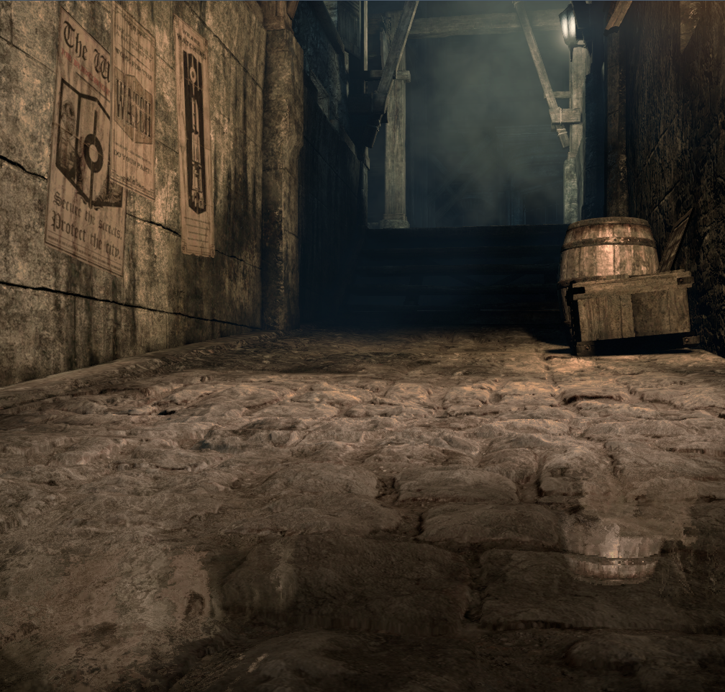
SSR/IBR Blending
SSR alpha depends on several factors
Height
Tracing accuracy (depth delta)
Surface horizontality
Ray goes out of screen
Ray goes back to the camera
“Just-because-I-don’t-want-SSR-here”
IBR merges on top, then cube map
Blending done in sRGB
On PS4 RGBA16F is used instead
Thief © 2014 Square Enix Ltd. All rights reserved.
Notes:
SSR outputs an alpha factor, which depends on several factors … Here is an image with SSR only

Slide 57
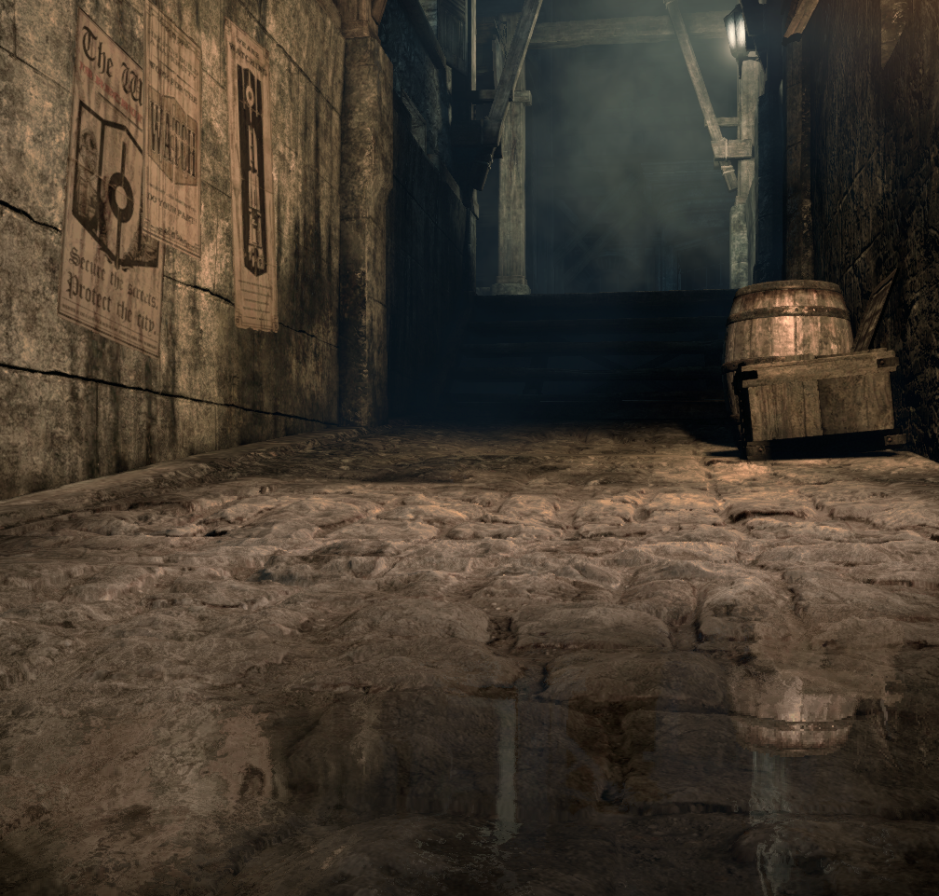
SSR/IBR Blending
SSR alpha depends on several factors
Height
Tracing accuracy (depth delta)
Surface horizontality
Ray goes out of screen
Ray goes back to the camera
“Just-because-I-don’t-want-SSR-here”
IBR merges on top, then cube map
Blending done in sRGB
On PS4 RGBA16F is used instead
Thief © 2014 Square Enix Ltd. All rights reserved.
Notes:
And here is the image with IBR merged with SSR

Slide 58
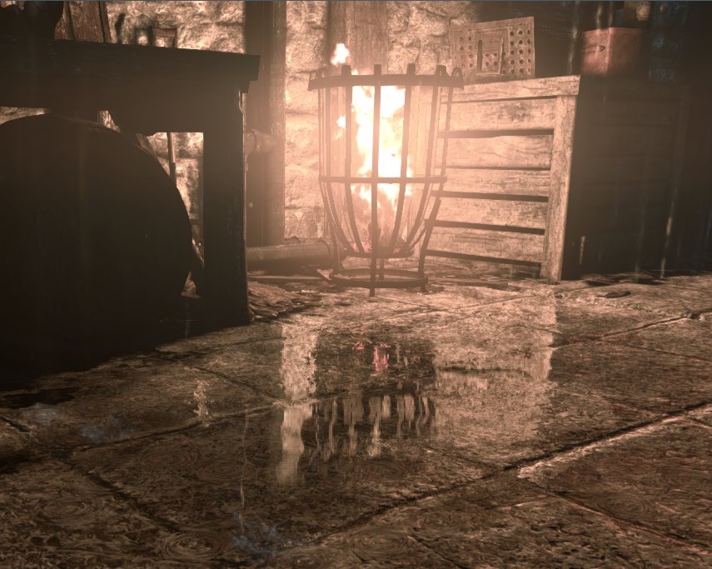
SSR/IBR No Sorting
Usually SSR is closer
Some objects (fire) are exceptions
Sorting in the IBR shader using distance
Thief © 2014 Square Enix Ltd. All rights reserved.
Notes:
However, we cannot always just blend IBR on top of SSR Therefore, we inject an SSR layer in the array of IBR targets and sort this array altogether
Here’s the rendering without sorting, notice there is no flame visible

Slide 59
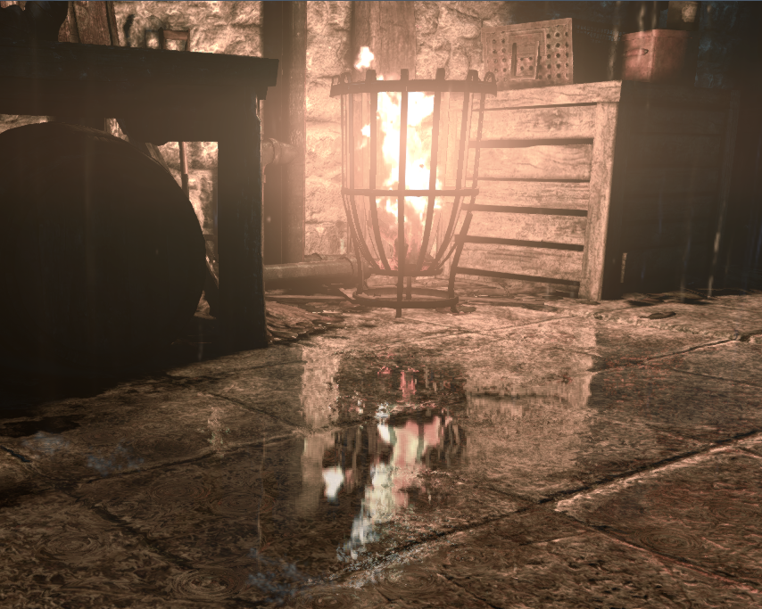
SSR/IBR With Sorting
Usually SSR is closer
Some objects (fire) are exceptions
Sorting in the IBR shader using distance
Thief © 2014 Square Enix Ltd. All rights reserved.
Notes:
And here is with sorting

Slide 60
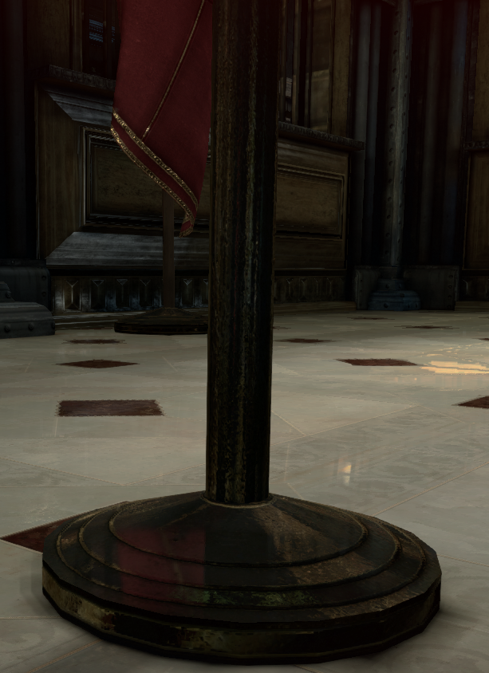
Reflection Bump (Before)
Normal is fixed during tracing
High-frequency information is lost due to half-res
Algorithm similar to refraction rendering
Thief © 2014 Square Enix Ltd. All rights reserved.
Notes:
We have already mentioned the bump as a post process
We need it as…
Besides
The algorithm can add not only high frequency bump, but also lower-frequency normal deviation Notice the red flag reflection before the bump mapping

Slide 61
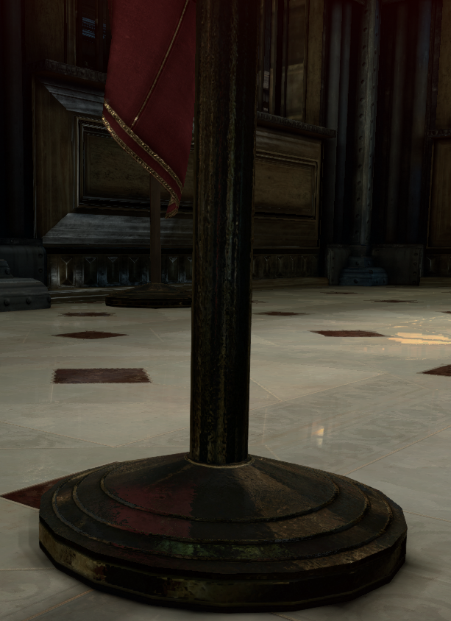
Reflection Bump (After)
Normal is fixed during tracing
High-frequency information is lost due to half-res
Algorithm similar to refraction rendering
All auxiliary steps timings ~2 ms
Thief © 2014 Square Enix Ltd. All rights reserved.
Notes:
And after

Slide 62
Talk Schedule
Basic algorithms
Thief reflection system overview
Screen-space reflections
Image-based reflections
Contact-hardening glossy reflections
Reflection pipeline features
Localized cube map reflections
Art pipeline implications
Conclusion and QA
Notes:
Ok, now Nic will discuss out localized cube map reflection system as well as the artistic pipeline

Slide 63
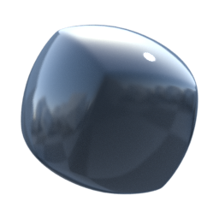
Artistic Pipeline
Localized cube map pipeline
Notes:
When I got on the project, CM were applied as material properties.
Conceptually reflection is an enviro property, not a material property.
LCM is nothing new, used back in SC3:CT
Here we use it as part of a global reflection strategy, rather than primary solution.
Of the 3 systems, artists only had to edit content for IBR and LCMs. SSR being a post effect was automatic.

Slide 64
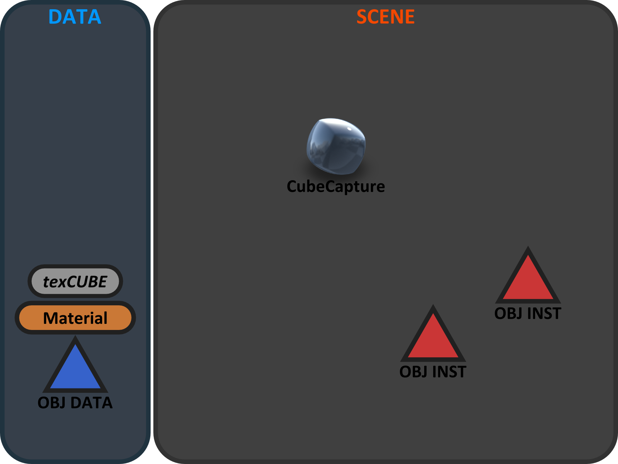
Artistic Pipeline
Notes:
Basic Overview

Slide 65
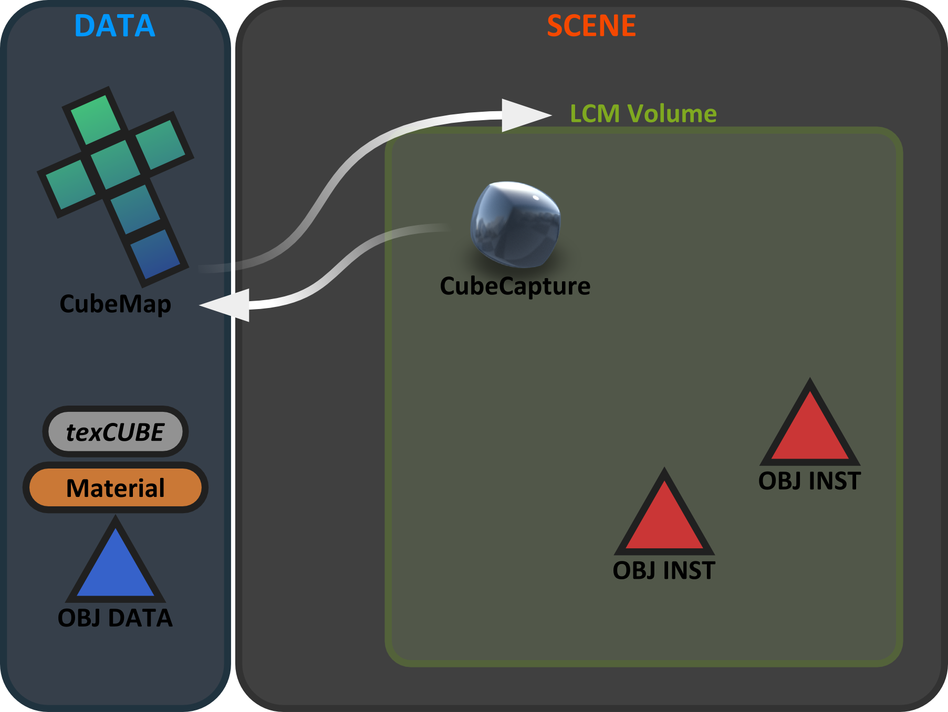
Artistic Pipeline
Notes:
Basic overview

Slide 66
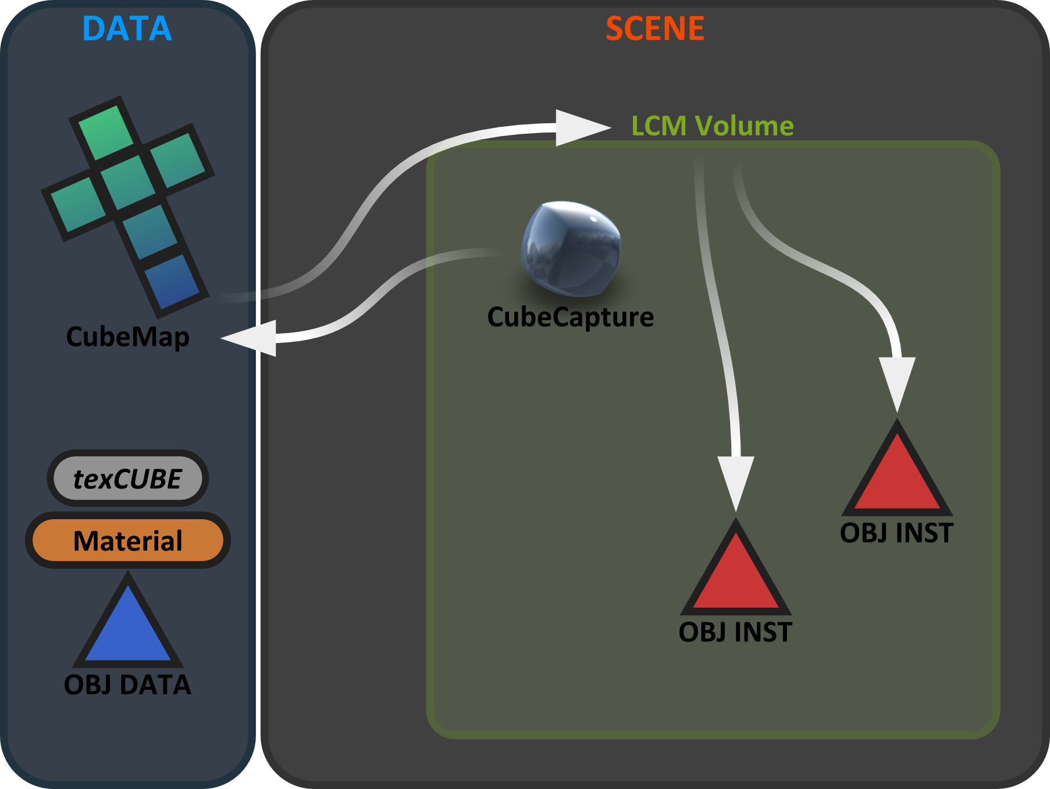
Artistic Pipeline
Notes:
Volumes pass CM reference to the object instances

Slide 67
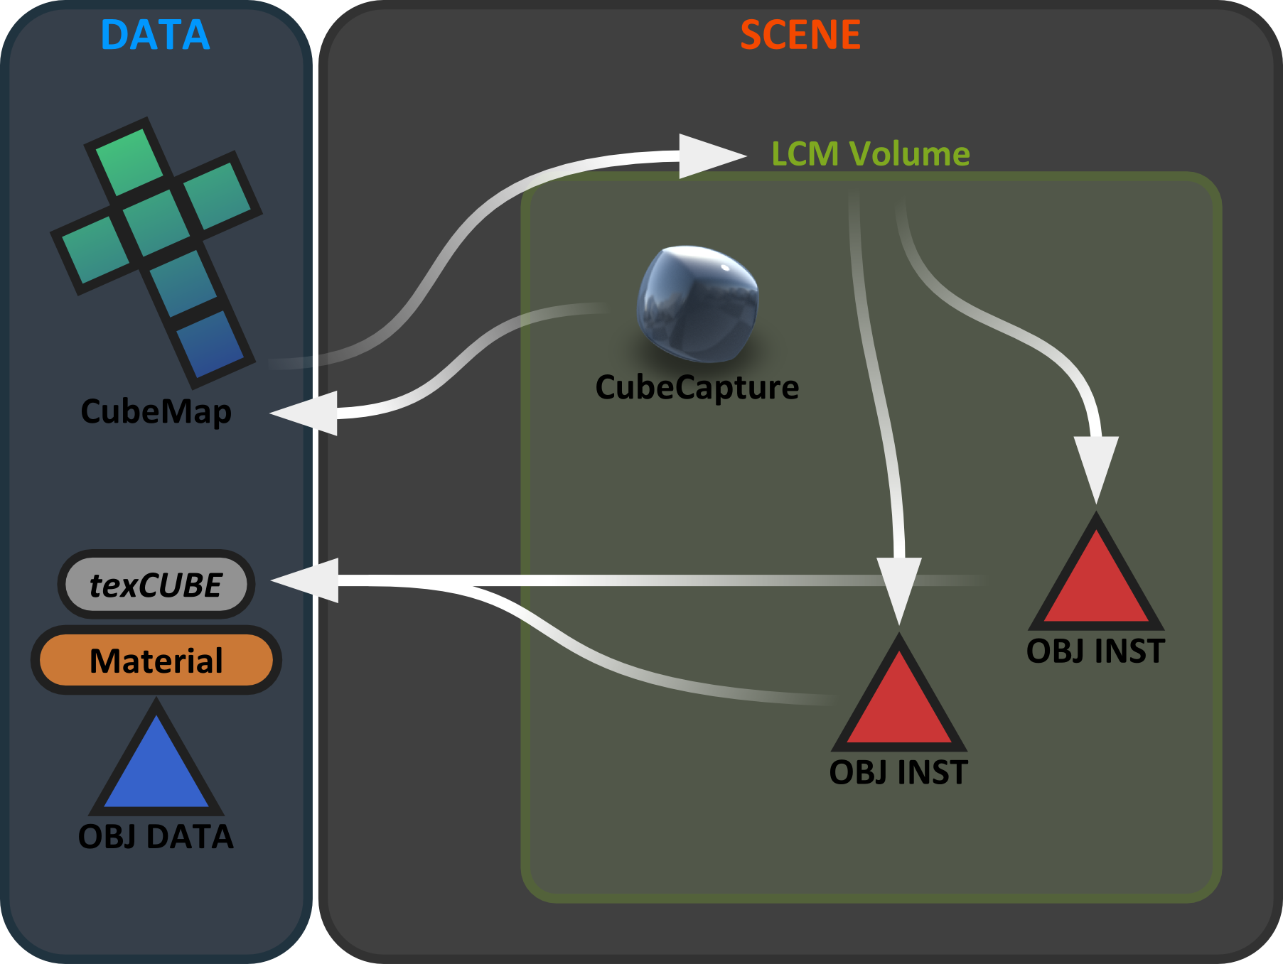
Artistic Pipeline
Notes:
Material texCube sampler gets cube reference from object instance

Slide 68
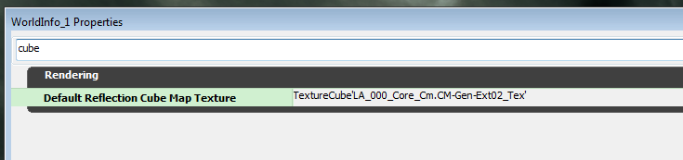
Artistic Pipeline
Localized cube map pipeline
Default cube map used on all SKUs
Thief © 2014 Square Enix Ltd. All rights reserved.
Notes:
World fallback. overrides and exceptions (dynamics, pickups)

Slide 69
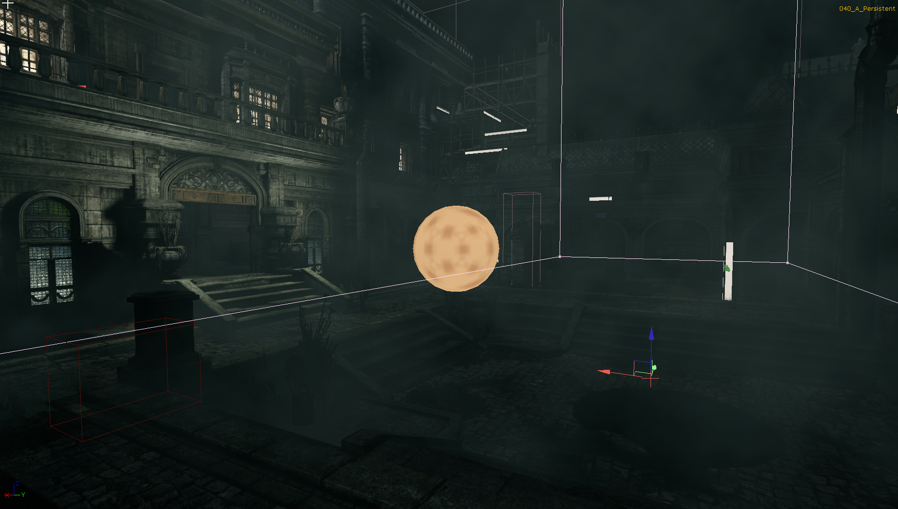
Artistic Pipeline
Localized cube map pipeline
Default cube map used on all SKUs
Volume construction
Thief © 2014 Square Enix Ltd. All rights reserved.
Notes:
Using normal unreal volumes.
Multiple volumes could be attached to the same capture actor, and reference the same cubemap
This solved for irregular shaped rooms and corridors.

Slide 70
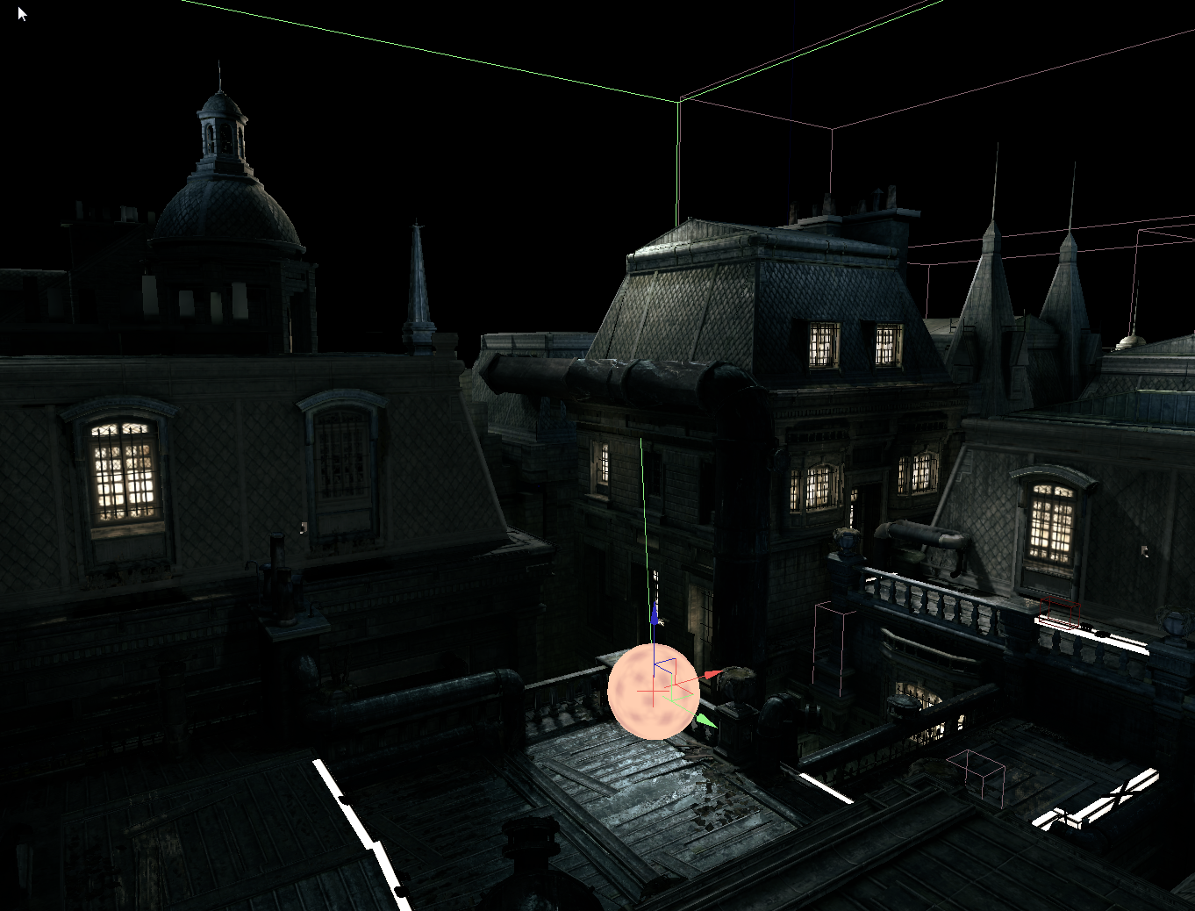
Artistic Pipeline
Localized Cubemap pipeline
Default cubemap used on all SKUs
Volume construction
Thief © 2014 Square Enix Ltd. All rights reserved.

Slide 71
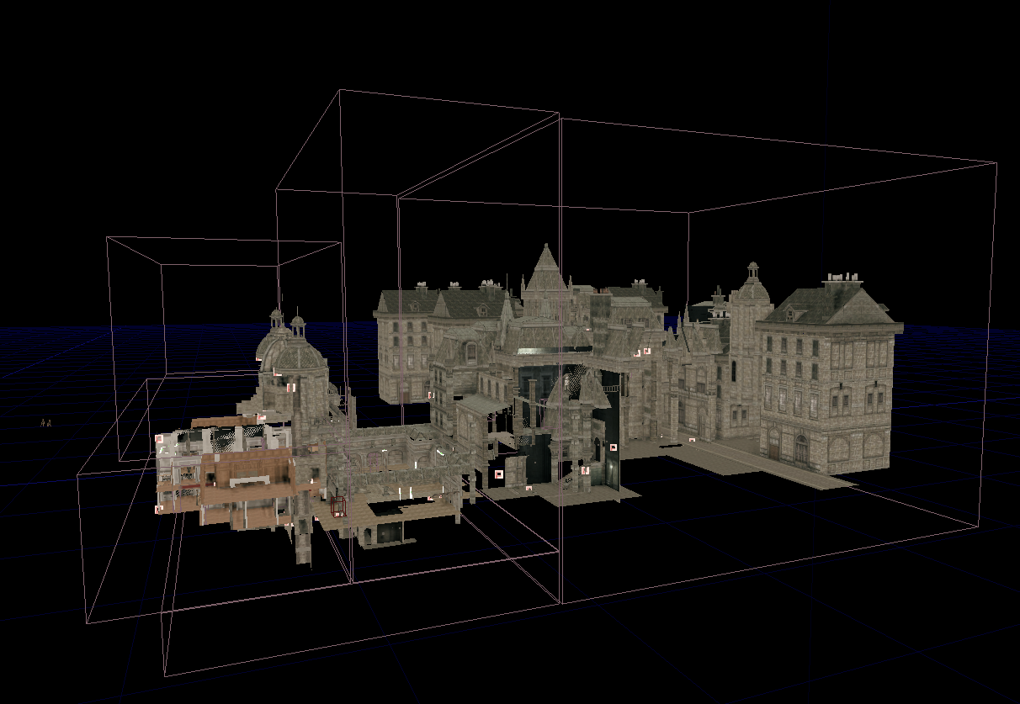
Artistic Pipeline
Localized Cubemap pipeline
Default cubemap used on all SKUs
Volume construction
Thief © 2014 Square Enix Ltd. All rights reserved.
Notes:
Fine refinement of volumes is not necessary
Since LCM is a coarse allback for finer detailed IBR and SSR

Slide 72
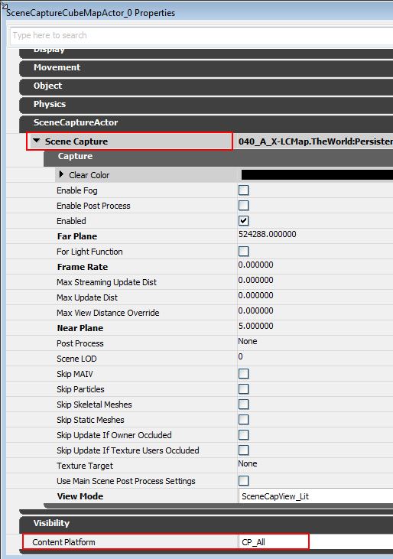
Artistic Pipeline
Localized Cubemap pipeline
Default cubemap used on all SKUs
Volume construction
Set the properties of the capture actors
Thief © 2014 Square Enix Ltd. All rights reserved.

Slide 73
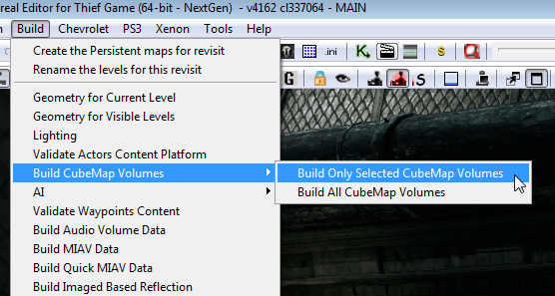
Artistic Pipeline
Localized cube map pipeline
Default cube map used on all SKUs
Volume construction
Set the properties of the capture actors
Build process to construct the cube map
Thief © 2014 Square Enix Ltd. All rights reserved.

Slide 74
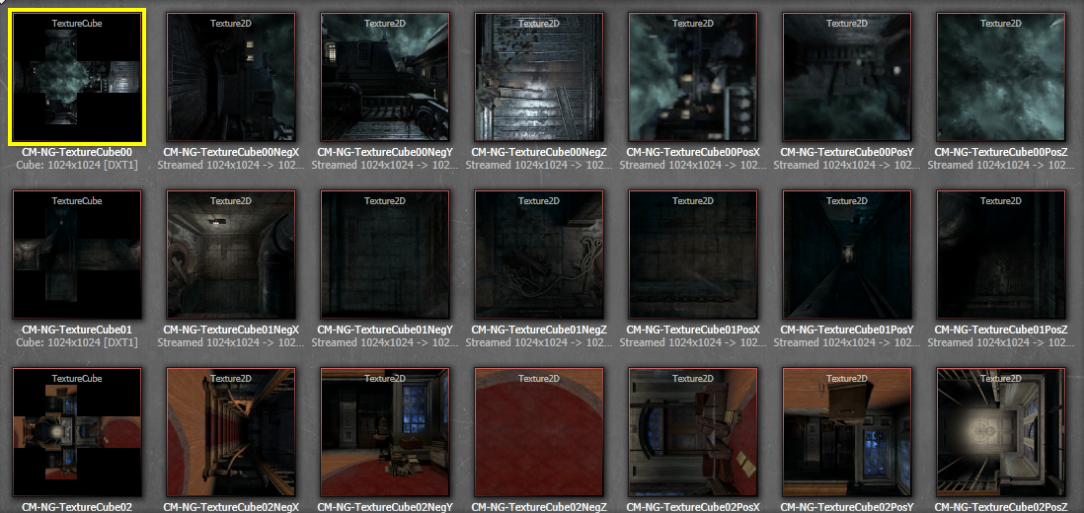
Artistic Pipeline
Localized cubemap pipeline
Default cubemap used on all SKUs
Volume construction
Set the properties of the capture actors
Build process to construct the cubemap
Cubemaps are saved and assembled
Thief © 2014 Square Enix Ltd. All rights reserved.

Slide 75
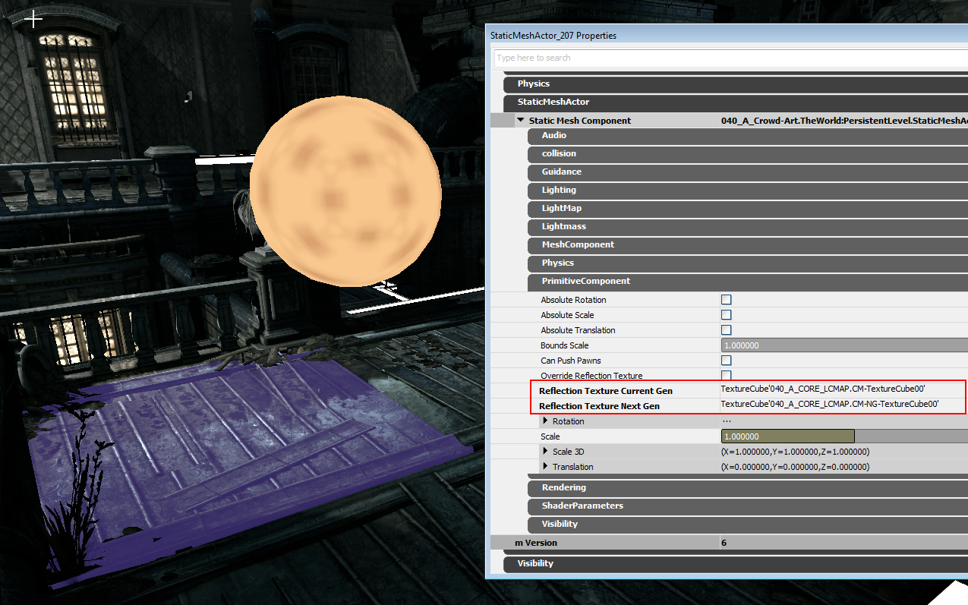
Artistic Pipeline
Localized Cubemap pipeline
Default cubemap used on all SKUs
Volume construction
Set the properties of the capture actors
Build process to construct the cubemap
Cubemaps are saved and assembled
Cubemaps are assigned to the meshes
Thief © 2014 Square Enix Ltd. All rights reserved.

Slide 76
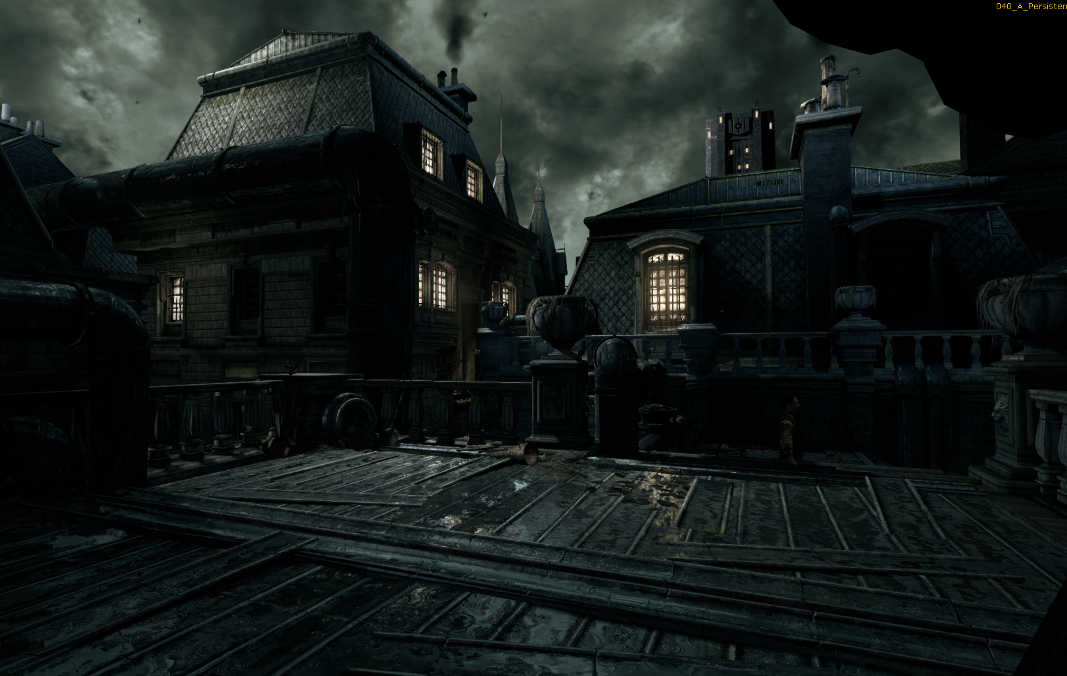
Artistic Pipeline
Localized Cubemap pipeline
Default cubemap used on all SKUs
Volume construction
Set the properties of the capture actors
Build process to construct the cubemap
Cubemaps are saved and assembled
Cubemaps are assigned to the meshes
Final result
Thief © 2014 Square Enix Ltd. All rights reserved.

Slide 77
Talk Schedule
Basic algorithms
Thief reflection system overview
Screen-space reflections
Image-based reflections
Contact-hardening glossy reflections
Reflection pipeline features
Localized cube map reflections
Art pipeline implications
Conclusion and QA
Notes:
Other Advantages etc.
Better environment integration of props and smaller items where IBR and SSR was not used
Better control over the number of cubemaps in mem, avoids accidental duplicates
Better strategy overall.

Slide 78
Artistic Pipeline
IBR creation pipeline
Notes:
(Missing graphic)

Slide 79
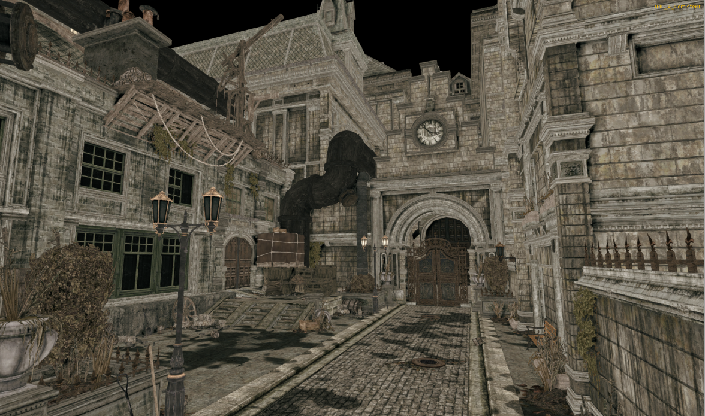
Artistic Pipeline
IBR creation pipeline
Pinpoint candidate areas for IBR reflections (i.e., water puddles)
Thief © 2014 Square Enix Ltd. All rights reserved.
Notes:
IBR could be expensive. We chose places where it would show.

Slide 80
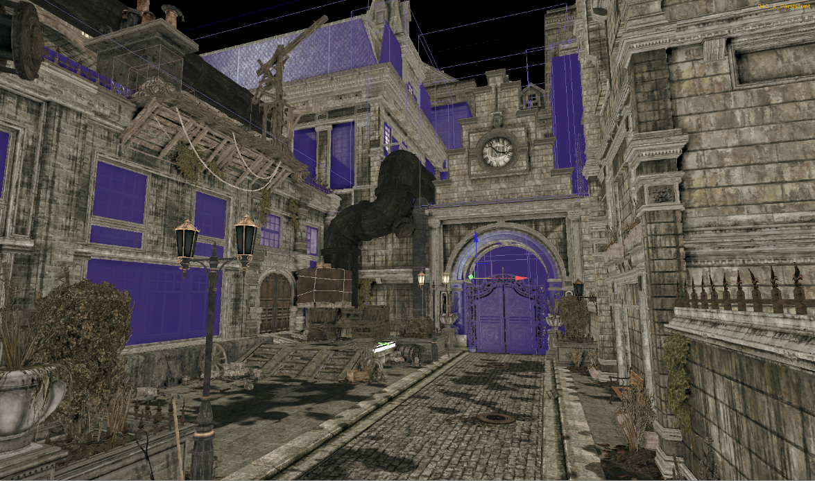
Artistic Pipeline
IBR creation pipeline
Pinpoint candidate areas for IBR reflections (i.e., water puddles)
Create the planes for main landmarks
Thief © 2014 Square Enix Ltd. All rights reserved.

Slide 81
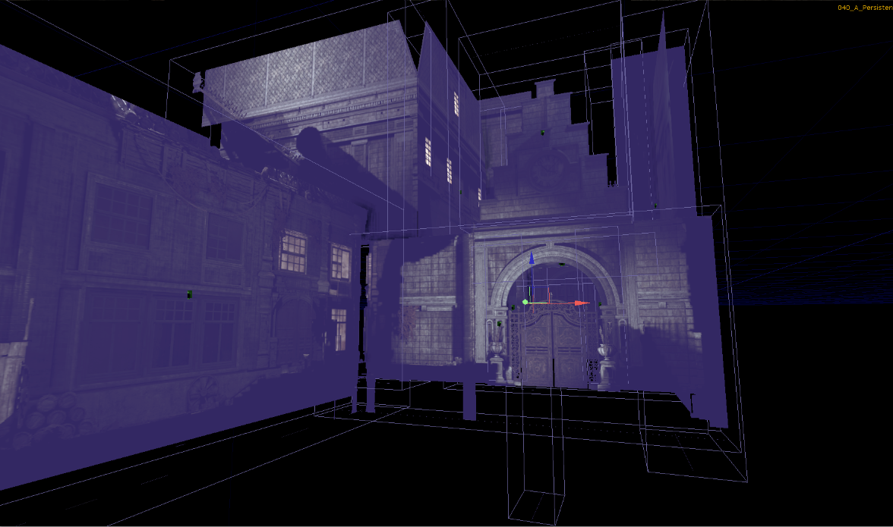
Artistic Pipeline
IBR creation pipeline
Pinpoint candidate areas for IBR reflections (i.e. water puddles)
Create the planes for main landmarks
Lit scene is baked to planes
Thief © 2014 Square Enix Ltd. All rights reserved.

Slide 82
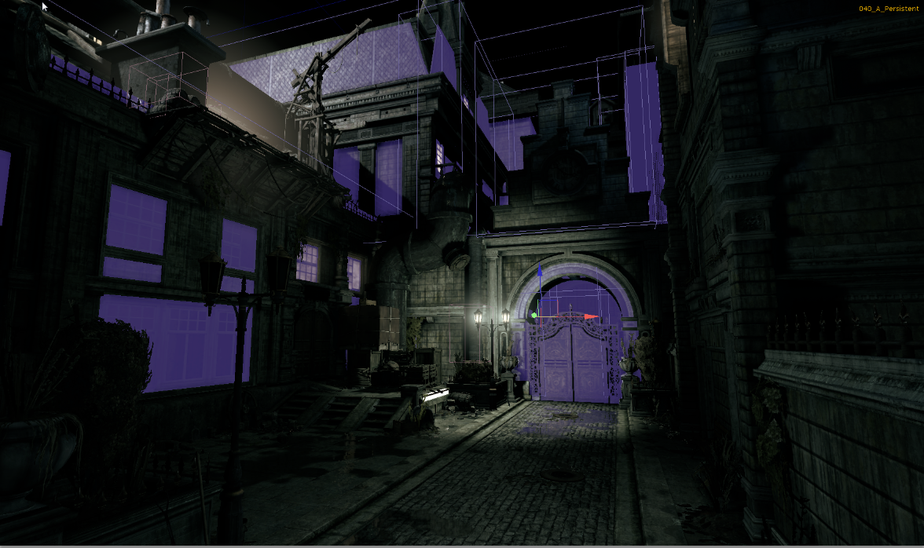
Artistic Pipeline
IBR creation pipeline
Pinpoint candidate areas for IBR reflections (i.e. water puddles)
Create the planes for main landmarks
Lit scene is baked to planes
Plane position and lighting adjustments
(plus addition of planes if needed)
Thief © 2014 Square Enix Ltd. All rights reserved.

Slide 83
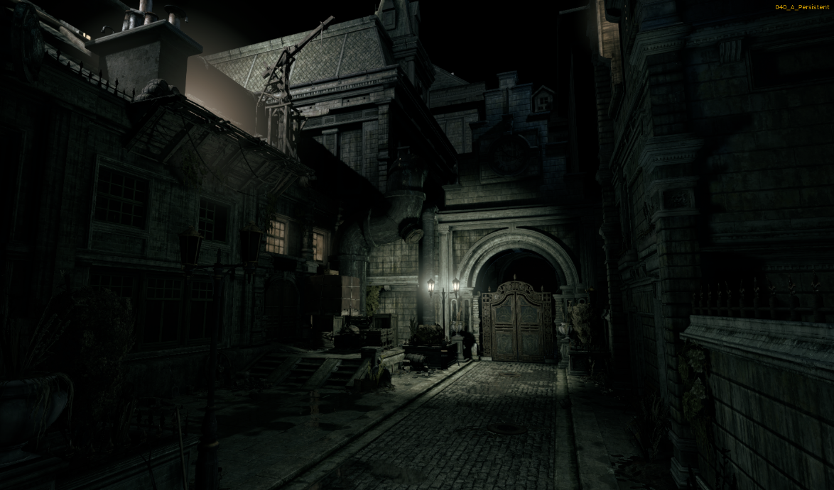
Artistic Pipeline
IBR creation pipeline
Pinpoint candidate areas for IBR reflections (i.e. water puddles)
Create the planes for main landmarks
Lit scene is baked to planes
Plane position and lighting adjustments
(plus addition of planes if needed)
Hide and move on to another zone
Thief © 2014 Square Enix Ltd. All rights reserved.

Slide 84
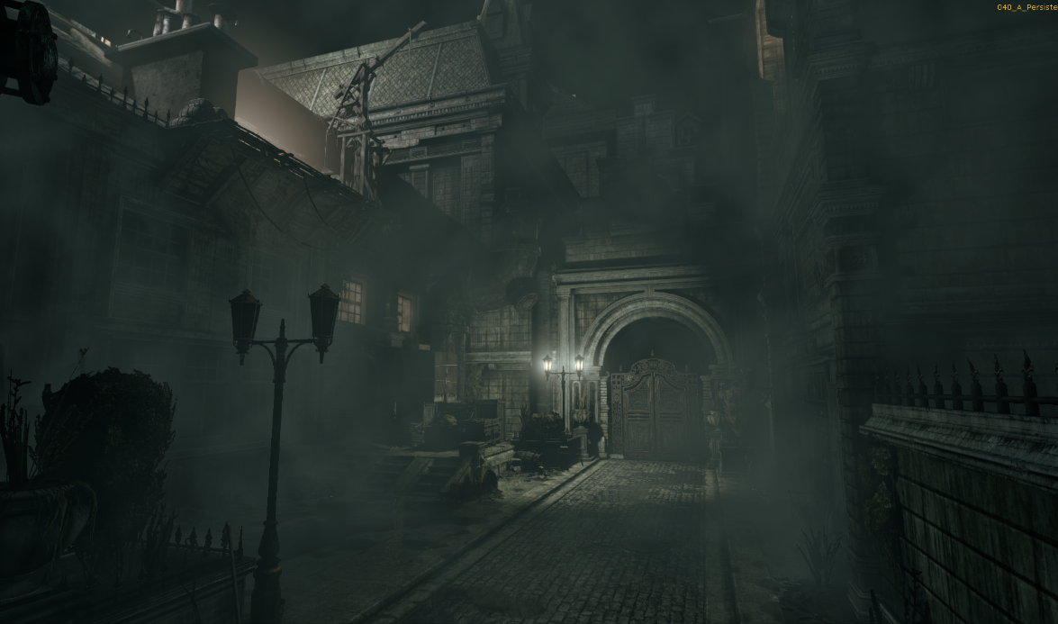
Artistic Pipeline
IBR creation pipeline
Thief © 2014 Square Enix Ltd. All rights reserved.

Slide 85
Artistic Pipeline
IBR creation pipeline
Video resume

Slide 86
Talk Schedule
Basic algorithms
Thief reflection system overview
Screen-space reflections
Image-based reflections
Contact-hardening glossy reflections
Reflection pipeline features
Localized cube map reflections
Art pipeline implications
Conclusion and QA

Slide 87
Takeaways
Real-time reflection is not a solved problem

Slide 88
Takeaways
Real-time reflection is not a solved problem
SSR needs a fallback

Slide 89
Takeaways
Real-time reflection is not a solved problem
SSR needs a fallback
Multi-tier solutions are/will be used

Slide 90
Takeaways
Real-time reflection is not a solved problem
SSR needs a fallback
Multi-tier solutions are/will be used
Mixed resolution rendering to save the bandwidth

Slide 91
Thanks
JN Bucci
Robbert-Jan Brems
Uriel Doyon
David Gallardo
Francis Maheux
and the whole Thief team!

Slide 92
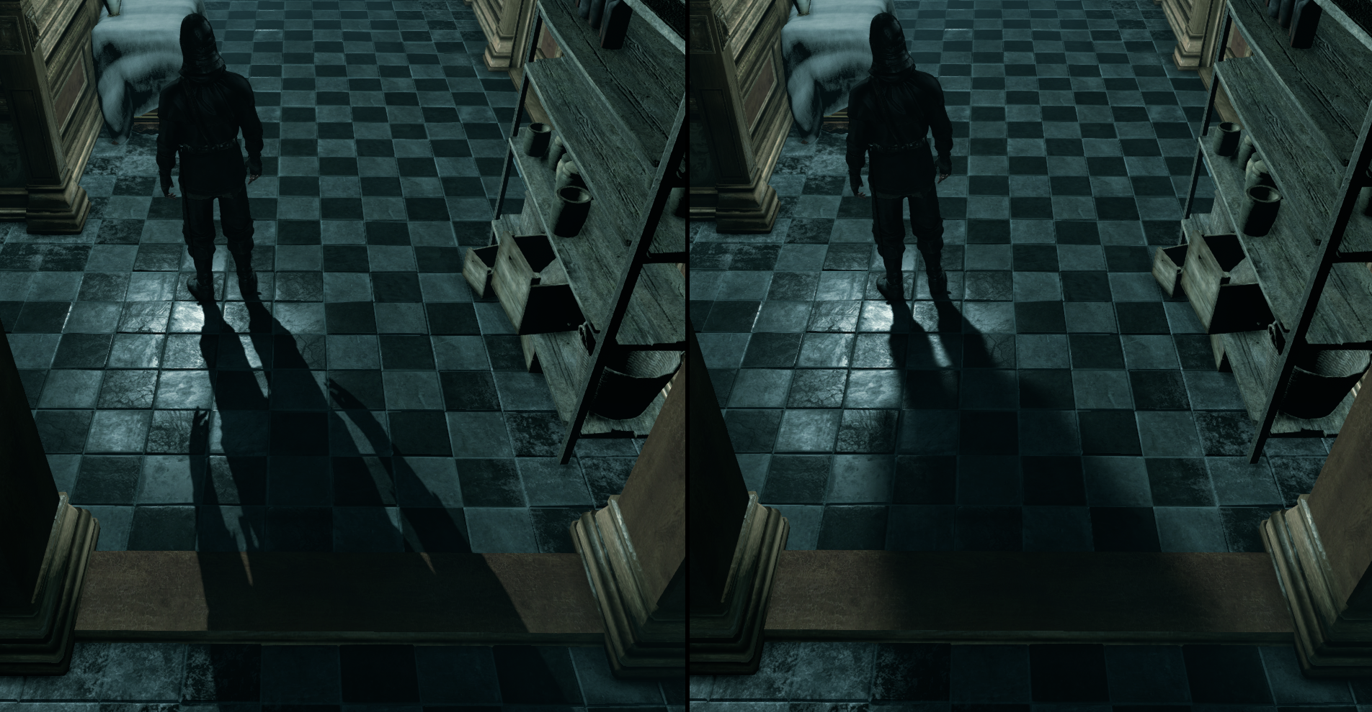
For More Details
Look out for our GPU Pro 6 chapter on Next-Gen Thief Rendering!
You will find:
Code listings for the algorithms
Contact-hardening shadows
Compute shader-based post processes
Parallax occlusion mapping
and more!
Thief © 2014 Square Enix Ltd. All rights reserved.

Slide 93

Thief © 2014 Square Enix Ltd. All rights reserved.
We are hiring!
Learn more at http://eidosmontreal.com/jobs

Slide 94

Questions?
Thief © 2014 Square Enix Ltd. All rights reserved.

